Slide 1
Planning and Estimation

Slide 2
Planning and Estimation
Story Points
time is not used to estimate work

Slide 3
Planning Poker
Rules
The developer team is handed out a pack of cards - usually a modified fibonacci sequence of numbers.
Next someone will read out a user story.
Each developer puts down an estimate with the number of story points they think that work will take.
The outlying story points must talk about why they chose that number in particular.
If there was a difference in the card numbers repeat from step 3.
If all cards are the same then move onto the next user story

Slide 4
Velocity
Velocity is the amount of work the team is able to get done in one Sprint
Velocity – how many story points the team can complete in one Sprint
Capacity – the size of the team, the length of the sprint, any absences within the team
Capability – the team’s knowledge and any impediments around this

Slide 5
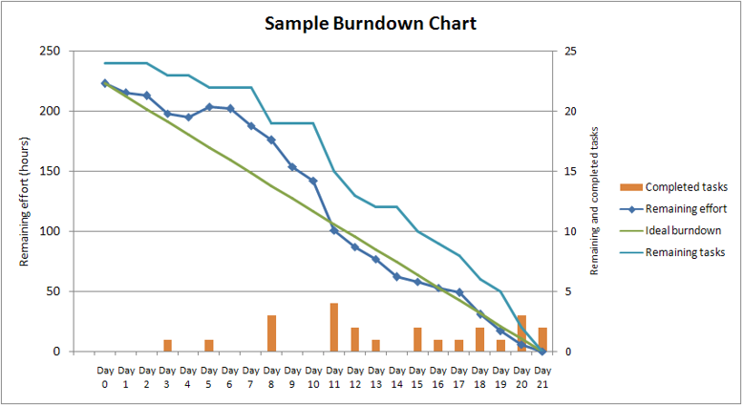
Burndown Charts

